Slide 1
Accountill: Invoicing Application
Software Testing Final Presentation
EEC 623/CIS 636 Software Quality Assurance

Slide 2

HELLO!
Anubhuti Dayal
Shruthi Gangineni
Suman Kumar

Slide 3
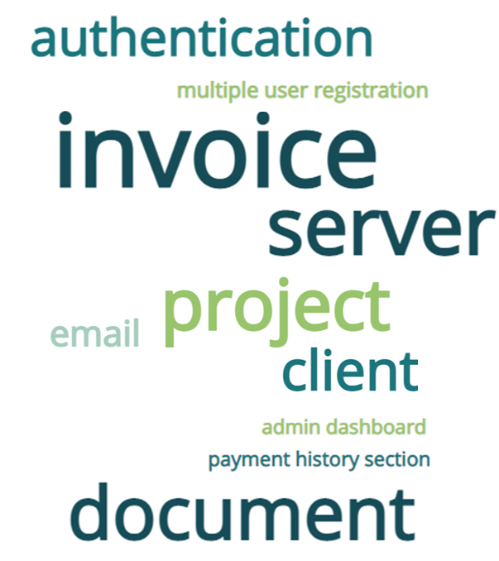
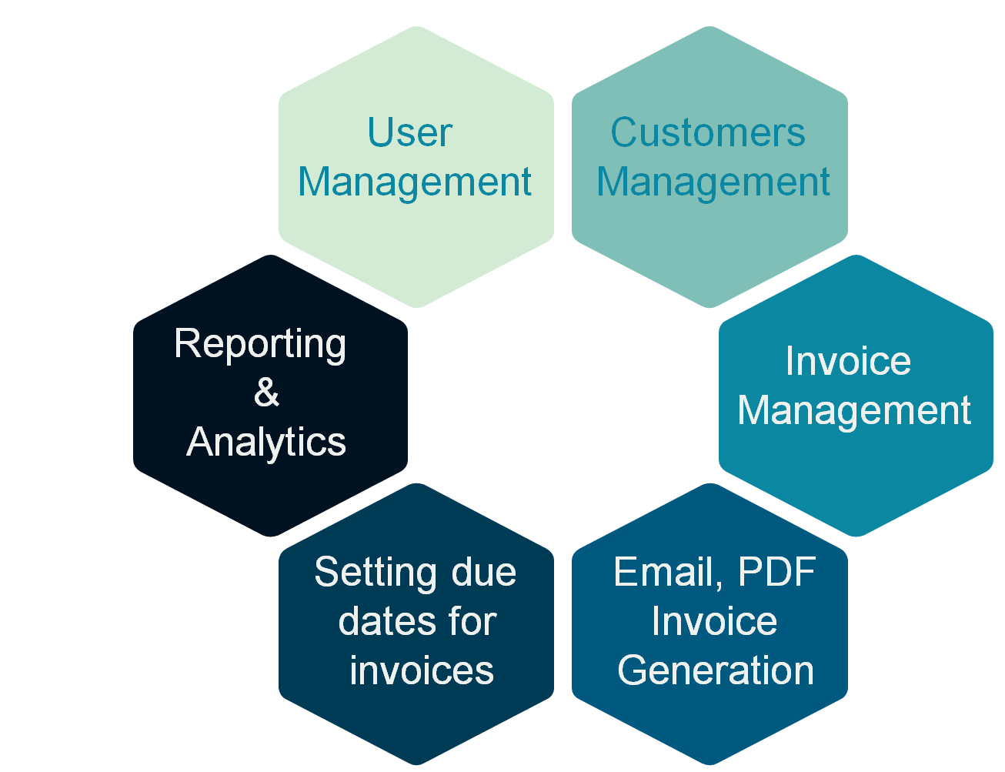
INTRODUCTION
What is the objective?
We have tested accounting software “Accountill”. It is an open-source Web-based application and the source code is taken from GitHub.
What is the software?
This is a finance management software.
Can be used to generate, download and send PDF versions of the documents via email
Has payment history section, the admin dashboard
Supports single & multiple user s
Registrations & authentication using JSON Web Tokens & Google authentication
source code Link : https://github.com/panshak/accountill
Website code : https://accountill.com/
Accountill- Free Invoicing App for Freelancers and Small Businesses
Notes:
We have tested an open source , web based Finance management application Accountill, This softwware helps user to manage their bills & invoices . User can generate document , email them or download pdfs. User can also review their payment history or check everything at Dashboard. This software also has capability to add multiple customer’s invoices so if any otheri firm wants to manage finance of multiple resources they can also use this application !

Slide 4
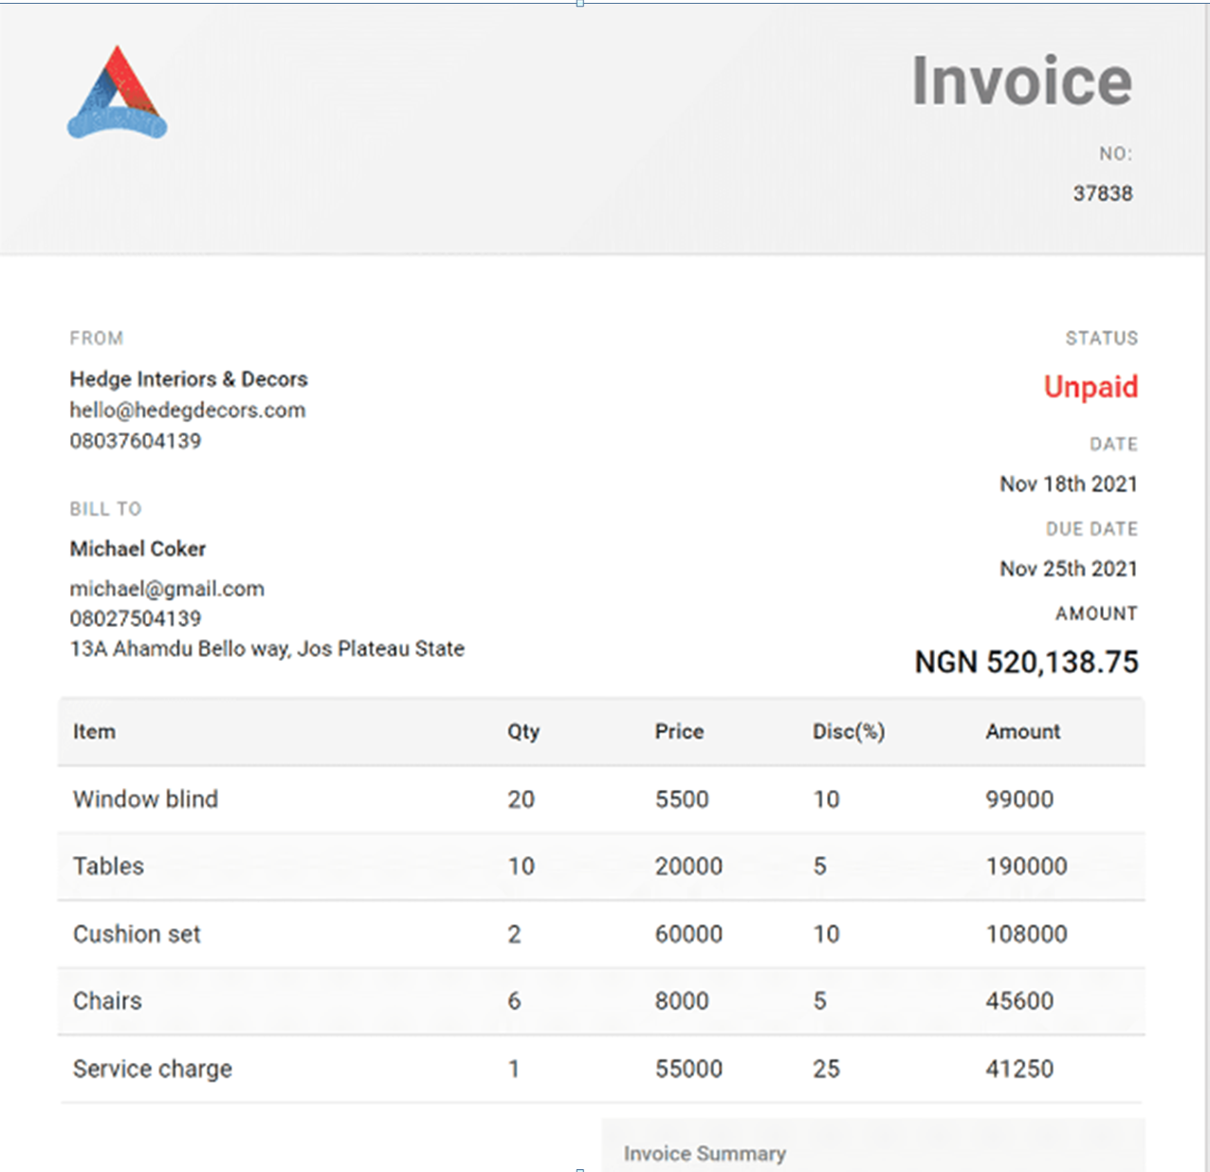
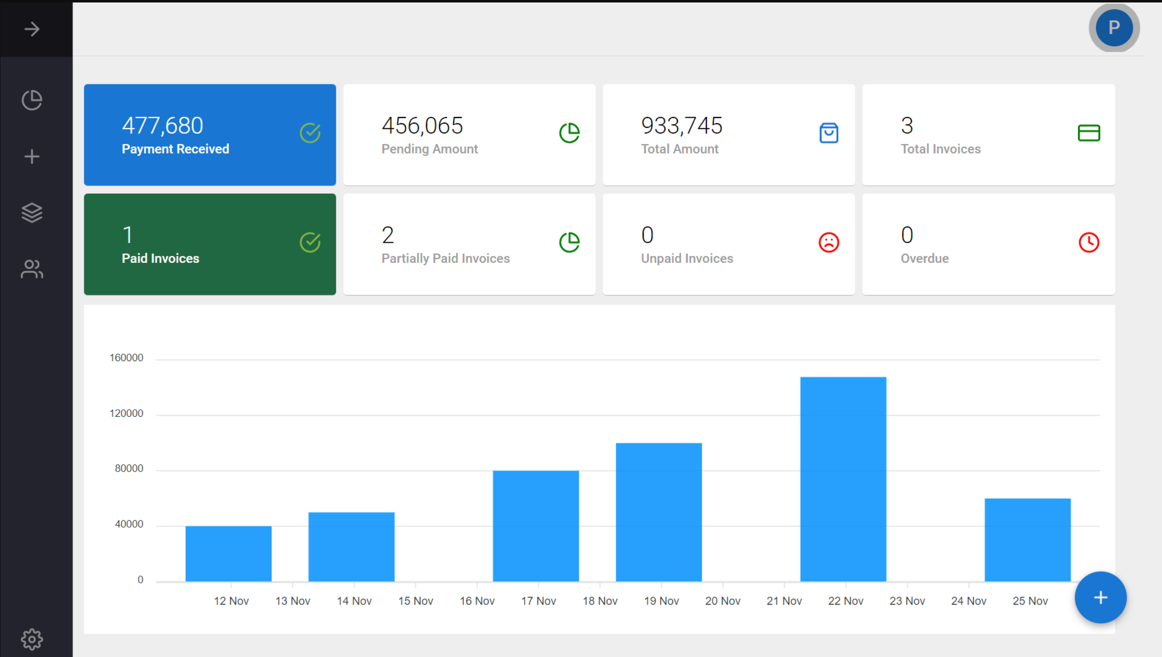
INVOICE & DASHBOARD
Developed by Panshak Solomon

Slide 5
ROADMAP
Project finalization
Week 1
Test plan submission
Week 3
Software Testing
Week 5-6
Final
Submission
Week 8
1
3
5
2
4
6
Project plan submission
Week 2
Design test cases on features of the software
Week 4
Project Demonstration & Submission
Week 7

Slide 6
TESTING
Let’s discuss about Testing the software

Slide 7
TASKS ASSIGNMENT
· User Management: | Shruthi
1. Registering new users.
2. Authenticating users using JWT token and Google OAuth.
3. Managing user accounts and profiles.
4. Resetting user passwords.
· Customers Management:
1. Adding new customers once logged in.
2. Performing CRUD over customer data.
· Invoice Management: | Suman
1. Creating new invoices.
2. Editing existing invoices.
3. Adding items to invoices.
4. Deleting items from invoices.
5. Displaying invoice details.
6. Adding and displaying notes to invoices.
• Reporting and Analytics:
1. Generating financial reports by generating charts.
2. Providing insights into financial data in the admin dashboard like displaying all invoice statistics including total amount received, total pending, recent payments, total invoice paid, total unpaid and partially paid invoices.
· Email and PDF Invoice Generation: | Anubhuti
1. Generating PDF invoices, receipts, estimates, quotations, and bills.
2. Sending invoices, receipts, estimates, quotations, and bills via email.
3. Downloading invoices, receipts, estimates, quotations, and bills in PDF.
· Setting due dates for invoices:
1. Automatically changing invoice status when payment is recorded.
2. Recording payment history for each invoice.
3. Allowing partial payment of invoices.
4. Displaying payment history and invoice status

Slide 8
ERRORS IN THE SOFTWARE
Let’s see errors found in the software

Slide 9
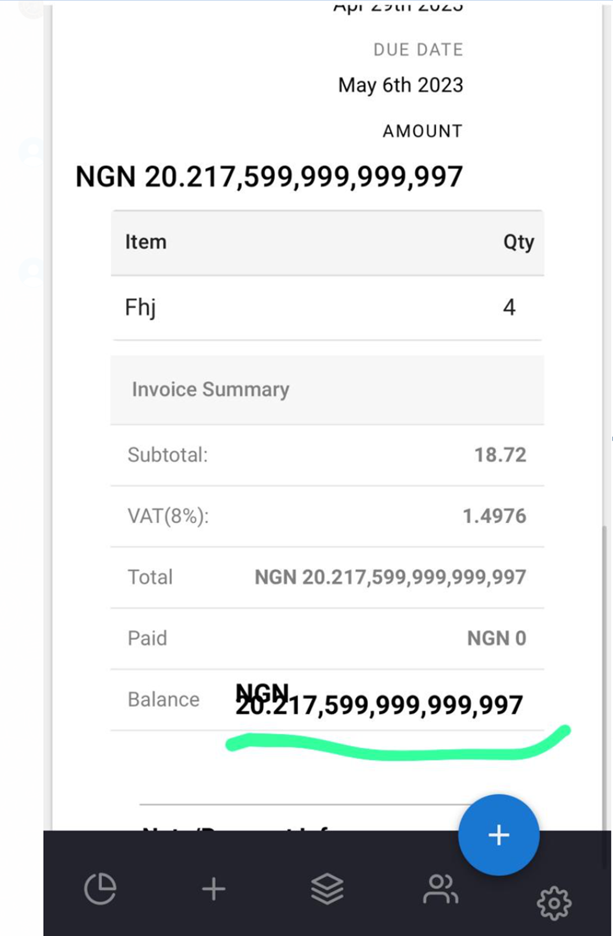
ROUNDING ERROR

Slide 10
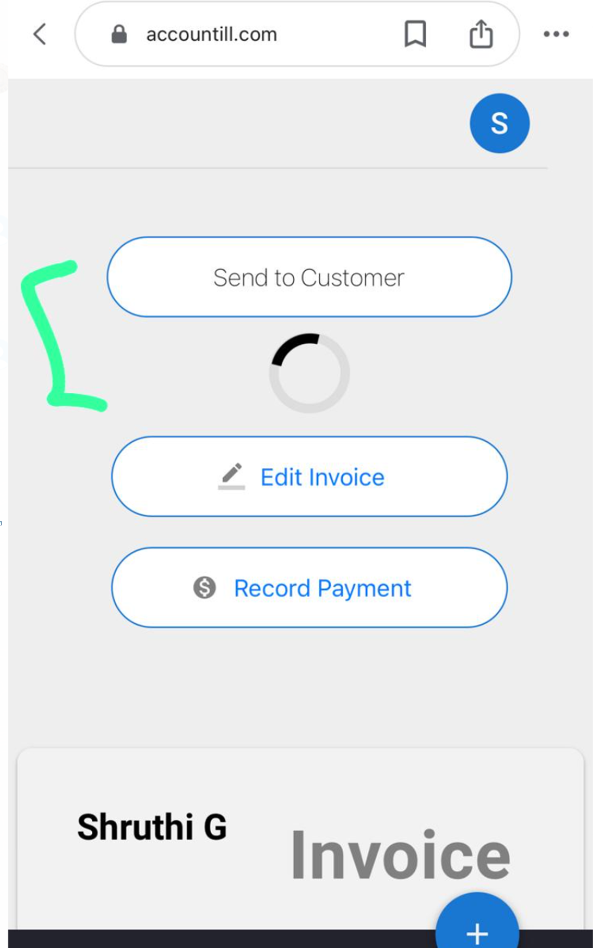
EMAIL is not being sent to the customer

Slide 11
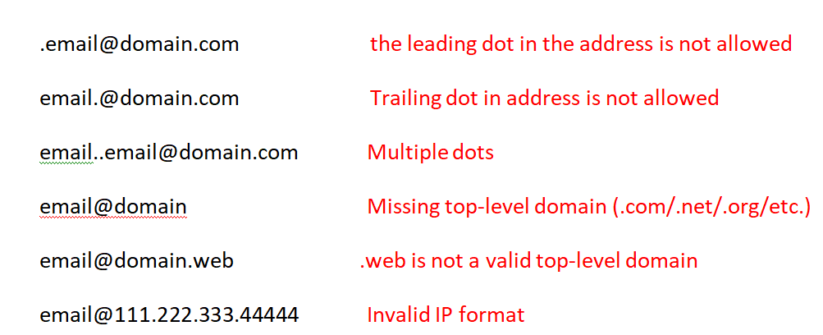
The system is allowing the below invalid email addresses
INVALID EMAIL ERRORS

Slide 12
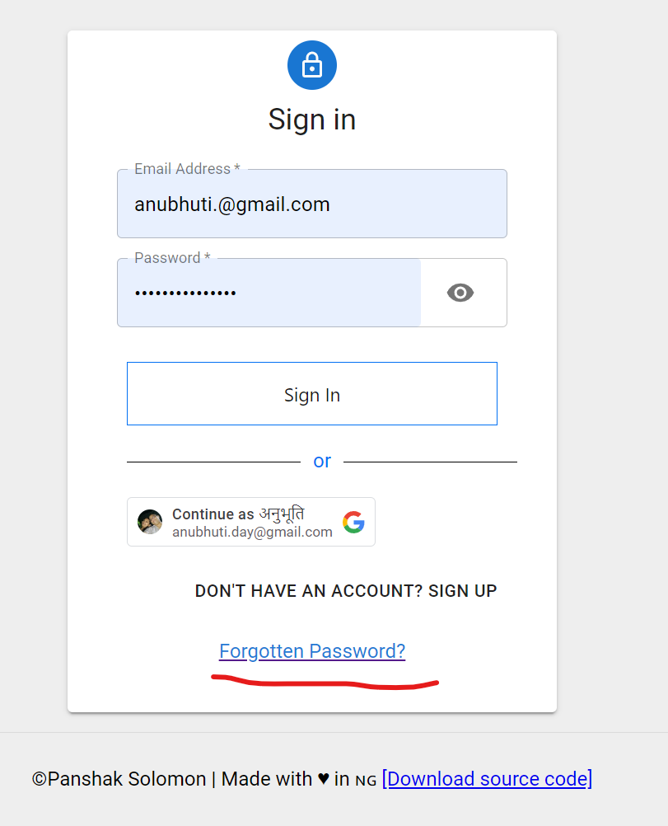
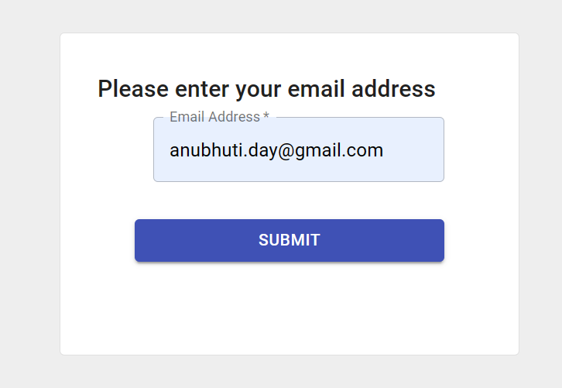
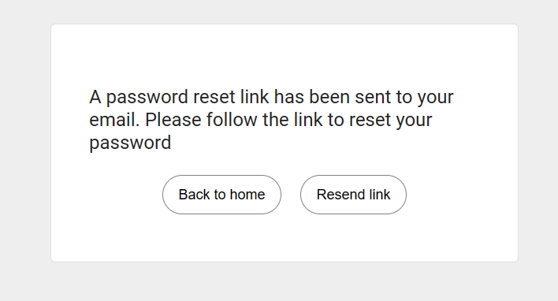
FORGOT PASSWORD ISSUE
No Email
is received :
User can
never reset
the password

Slide 13
RESULTS
It’s time to see results

Slide 14
RESULTS & CONCLUSION
 | Test Counts
TOTAL EXECUTED | 28
Pass | 17
Fail | 11
The software is good , but required to fix minor issues along with email validation and send functionality.

Slide 15
THANKS!
Any questions?
You can find us at:
@2824826 ,@ 2826027
@ 2861070

